Slide 1
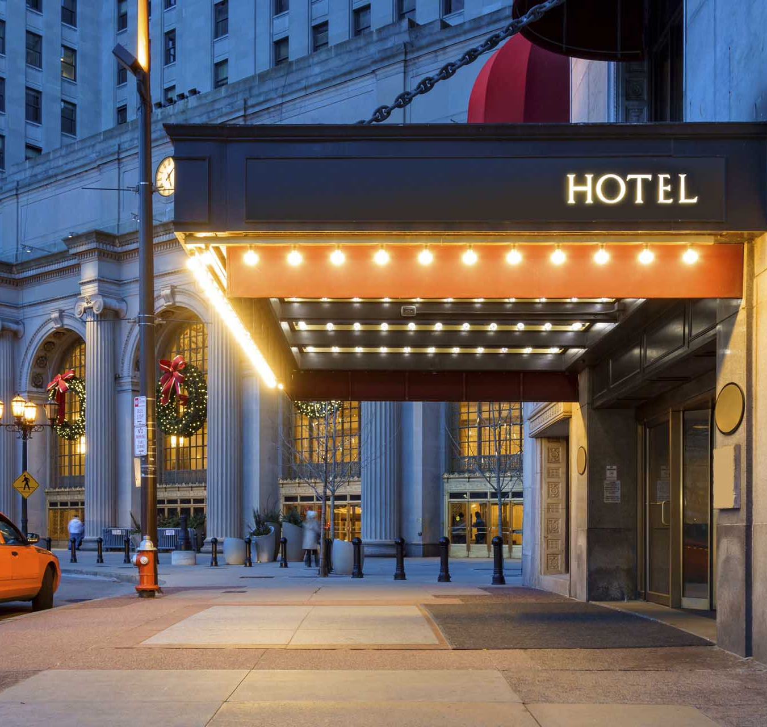
Hotel Management System
Meet Gajra-1911011
Shubh Gosalia-1911015

Slide 2

Problem Definition
To manage a huge property like a hotel is no easy task right from managing your staff, your rooms to handling customer needs and records.
Manual work is never an option in such scenarios and it requires a proper management system to carry out daily operations.
Thus, a hotel management system is an apt solution to this problem.

Slide 3

SCOPE
User can book a room given the room is available or is not under renovation.
Unbook/Unreserve a room
User can filter out rooms as per his/her requirements i.e Room Type, availability of AC. etc.
Information regarding the rooms such as its type, pricing and availability status can be checked in a separate section. If room is booked, the record of the person who booked it is visible.
New rooms can be added via database connectivity.
Hotel status such as the no. of staff, available rooms, total customers is displayed and dynamically updated.
On a successful booking, bill can be generated.

Slide 4
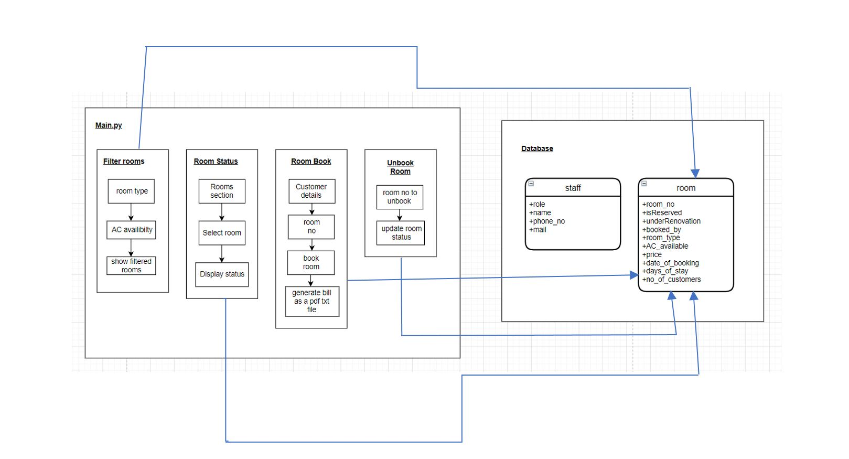
Component Diagram

Slide 5
API or Package Used
Tkinter Module:
1.) Message Box
2.)TTK with tkinter
3.)Combobox
Re Module: Regular expressions for checking phone number and email
MySQLdb Module: Database Connectivity and Query Handling
datetime Module: To show the room booking date by a customer, also printed on bill
PIL Module To display images
Os Module To create txt files for bills

Slide 6
Difficulties Faced
What do you believe to be true about your subject?
What are you going to try to convince your audience of?

Slide 7

Concepts Used
Tkinter Module:
1.) Message Box
2.) TTK with tkinter
3.) Combobox
Database Connectivity using MySQL DB.
Display images using PIL Module
Regular Expressions
Exception Handling
File Handling

Slide 8
Teamwork
Implementation | By
UI Design | Shubh Gosalia
Front-End | Meet Gajra, Shubh Gosalia
Database Design and Connectivity | Meet Gajra
Query Handling | Meet Gajra, Shubh Gosalia
Filter Rooms | Shubh Gosalia
Hotel status and rooms status | Meet Gajra
Room Booking | Meet Gajra, Shubh Gosalia
Bill Generation | Meet Gajra, Shubh Gosalia

Slide 9

References
1.https://stackoverflow.com/questions
2. https://www.geeksforgeeks.org/python-regex/
3. https://www.javatpoint.com/python-tkinter
4.https://www.w3schools.com/python/python_mysql_getstarted.asp

